Slide 1
Master Thesis: Forecasting project success using JIRA data
Mark Fromm
Business Information Systems

Slide 2
RQ: How can we predict project success using JIRA data on DWC?
What type of data do we need to define project success?
How can we combine this data?
Which Machine Learning Algorithms suit for this type of problem?
How can we use the SAP DWC and ist features to build an Analytics environment?

Slide 3

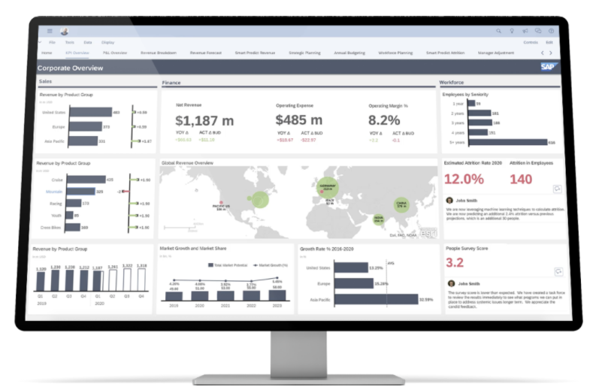






Current Architecture
Visualizing the outcome using SAP Analytics Cloud
SAC
Data is being loaded and transformed inside the SAP Data Warehouse Cloud
DWC
Data is being extracted with a Python ETL script using Jira-API
ETL
Source System
Project Data from Jira

Slide 4





Target Architecture
Project Data
Additional Data
Prediction

Slide 5
Target Class ‚project_success‘
is not defined in the dataset
must be created based on other figures
literature review to find key figures and define project success for the project data

Slide 6
SAP Data Warehouse Cloud
Pros and cons for cloud-based DWH in context of Machine Learning
through the example of SAP Data Warehouse Cloud
Are there native methods to combine data sources which can be used for Machine Learning?
E.g. SAP Data Market Place?

Slide 7
First ideas
Methodology
Motivation
Problem statement
Dataset exploration

Slide 8
Systematic analyzation on the models applied on
Abstract max 300 words

